Slide 1

Turbulence Modelling for Smoothed Particle Hydrodynamics
K T Prajwal Prathiksh
Dual Degree Project (Stage I) - Presentation
Supervisor: Prof. Prabhu Ramachandran
Department of Aerospace Engineering
Indian Institute of Technology Bombay
October 25th, 2022
Notes:
Buy Aeroelasticity (Dover Books on Aeronautical Engineering) Book Online at Low Prices in India | Aeroelasticity (Dover Books on Aeronautical Engineering) Reviews & Ratings
Merging Radius between two vortices
Summarize the russian paper
Sine wave/Saw tooth wave/Squre wave - heaving motion for the cylinder

Slide 2
Introduction
Turbulent Flow
Characterization
High Reynolds number flows
Random spatial & temporal velocity fluctuations
Rotational & 3D velocity field
Large mixing capacity of the flow
Chaotic nature of solutions
Modelling
Lacks analytical solutions except for simple cases
CFD simulations required for complex flows
Typical modelling techniques
Governing equations → Averaged or filtered
Closure problem → Fluctuating components modelled using mean flow properties
Stochastic methods
Models mostly based on Eulerian framework
Lagrangian Modelling – SPH
No background mesh
Handles large deformations, complex boundary dynamics
Simplified model implementation
Highly & efficiently parallelizable

Slide 3
Project Objectives
Turbulence Modelling in SPH
Lacks robust & accurate models
Shortcomings of current models:
Cannot be generalized to various types of turbulence-based problems
Issues in scaling to 3D turbulent flows
Accuracy & computational constraints
Boundary conditions & treatment not well established
Project Objective
Review state of the art turbulence models in SPH
Provide advantages & disadvantages of the major categories of models
Extend promising models to robust & accurate SPH schemes^{[1]}
Analyze & study its performance in bounded turbulent flow
Improve overall scheme using recent developments of SPH
Existing
Models
Expected
Outcome
[1] P. Negi and P. Ramachandran, “How to train your solver: A method of manufactured solutions for weakly compressible smoothed particle hydrodynamics,” Phys. Fluids, vol. 33, no. 12, 2021, doi: 10.1063/5.0072383.

Slide 4
Project’s Progress
Surveyed research papers detailing work on turbulence models for SPH (c. 2000 – 2022)
Classified 5 major categories of turbulence models
Identified a systematic, model-evaluation method
Benchmark problems feasible with SPH
Post-simulation analysis techniques
Turbulence Modelling
Turbulence Models
Viscosity
LES
Lagrangian-LES
RANS
LANS
Artificial
Stochastic
Implicit P-Poisson
Explicit P-EOS

Slide 5
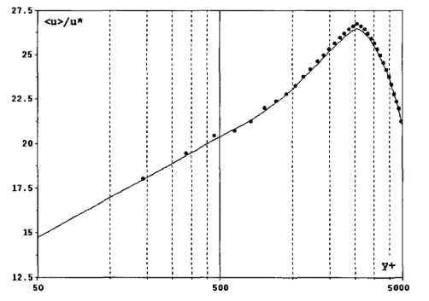
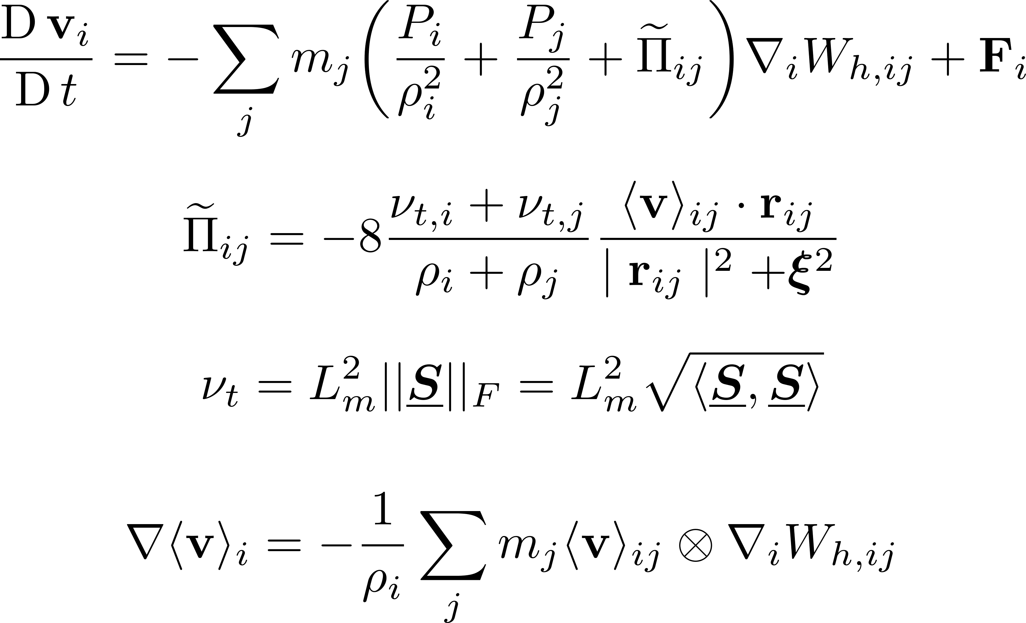

Viscosity-based Models
Eddy Viscosity Model^{[1]}
One of the first classes of SPH turbulence models
Velocities are Reynolds-averaged
First-order closure model:
Reynolds stress tensor & mean velocity gradients
Turbulent eddy viscosity considered
Simulated Poiseuille flow $(Re = 6.4×{10}^{4})$
Comments
Reproduced log-law profile near walls
Appropriate for shear flows
Fig: Computed mean velocity profile of turbulent Poiseuille flow in a pipe (Rep: Violeau et al)
[1] D. VIOLEAU, S. PICCON, and J.-P. CHABARD, “TWO ATTEMPTS OF TURBULENCE MODELLING IN SMOOTHED PARTICLE HYDRODYNAMICS,” in Advances in Fluid Modeling and Turbulence Measurements, Jul. 2002, vol. 1, no. 5, pp. 339–346, doi: 10.1142/9789812777591_0041.

Slide 6
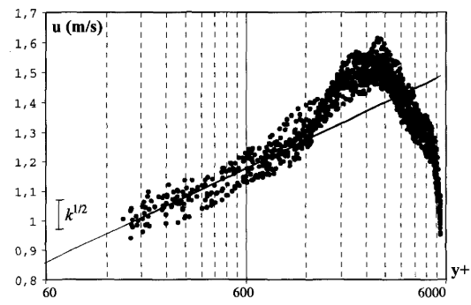
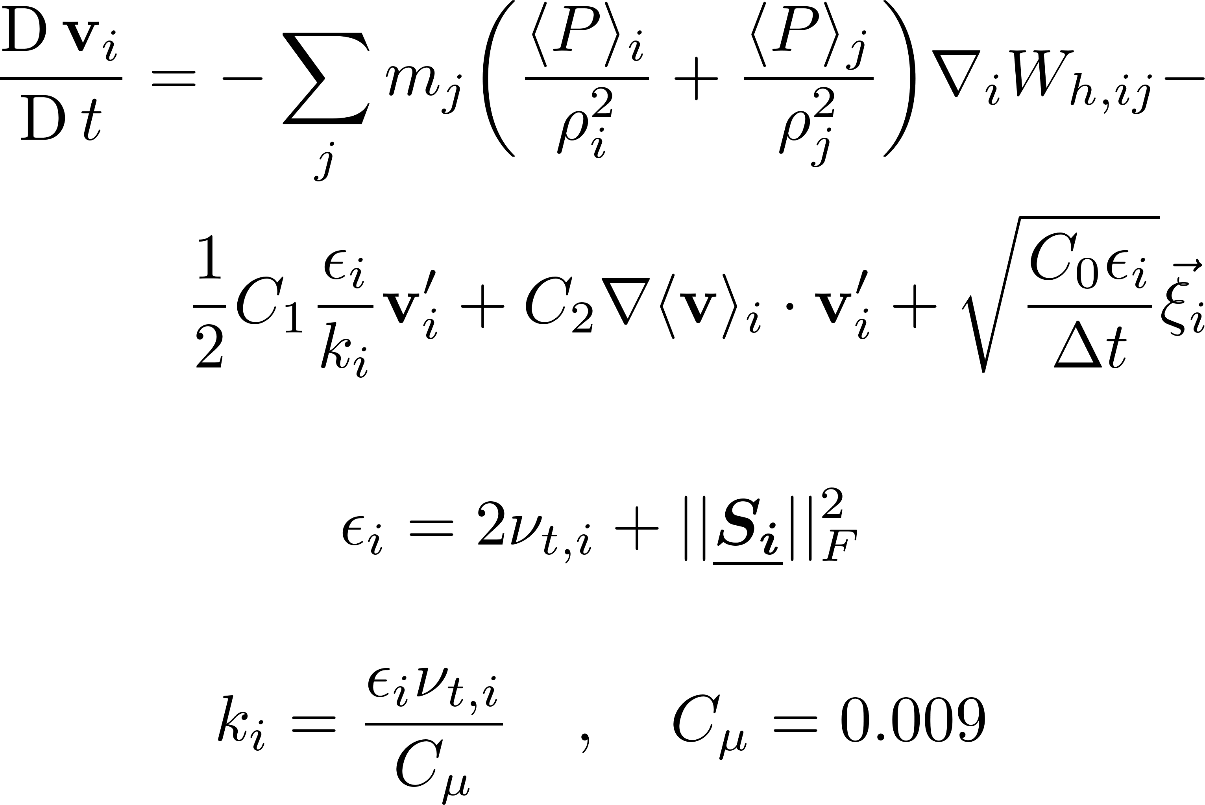

Viscosity-based Models
Generalized Langevin Model^{[1]}
Prescribed the particle velocity as a random process
Acceleration → Function of a random vector (non-correlated with velocity)
Simulated Poiseuille flow $(Re = 6.4×{10}^{4})$
Comments
Mean operator appeared to behave like a LES filter
Large deviations observed in mean velocity profile $(∝k^{0.5})$
Can be generalized to various types of turbulent flows, & not only shear flows
Fig: Computed mean velocity profile of turbulent Poiseuille flow in a pipe (Rep: Violeau et al)
[1] D. VIOLEAU, S. PICCON, and J.-P. CHABARD, “TWO ATTEMPTS OF TURBULENCE MODELLING IN SMOOTHED PARTICLE HYDRODYNAMICS,” in Advances in Fluid Modeling and Turbulence Measurements, Jul. 2002, vol. 1, no. 5, pp. 339–346, doi: 10.1142/9789812777591_0041.

Slide 7
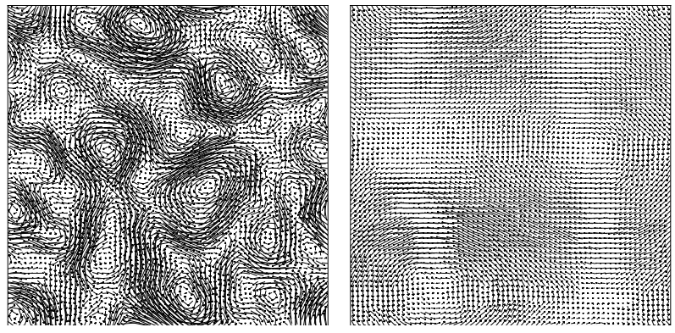

Viscosity-based Models
Modified-SPH (mSPH)^{[1]}
Observation: Absence of viscosity → Noisy particle motion
Finite viscosity → Over-prediction of dissipation
Modified EOS & MOM eqs. → Particle distribution homogenised
Simulated:
2D Taylor-Green Vortex (TGV) $\left(Re =∞, N_{i}={64}^{2}\right)$
3D Taylor-Green Vortex (TGV) $\left(Re =400, N_{i}={64}^{3}\right)$
Comments
Merging of vortices observed
Energy cascade (Kolmogorv scale) slopes reproduced
mSPH (-3); standard SPH (1)
Transitional flow simulated with reasonable dissipation rate
mSPH $∼$ Eddy viscosity model below numerical resolution
Fig: Velocity vector plot at t=2 (left) and t=30 (right). (Rep: Adami et al)
[1] S. Adami, X. Y. Hu, and N. A. Adams, “Simulating three-dimensional turbulence with SPH,” 2012.

Slide 8
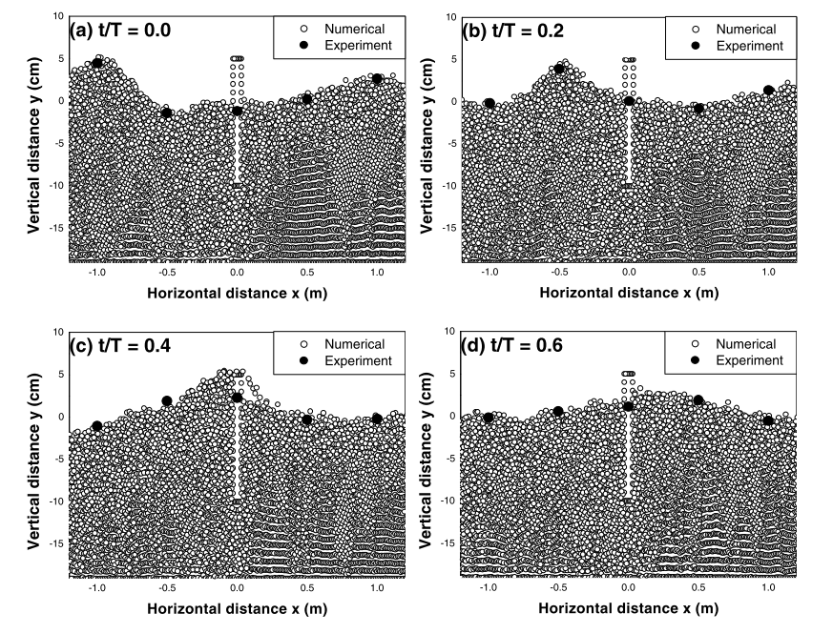
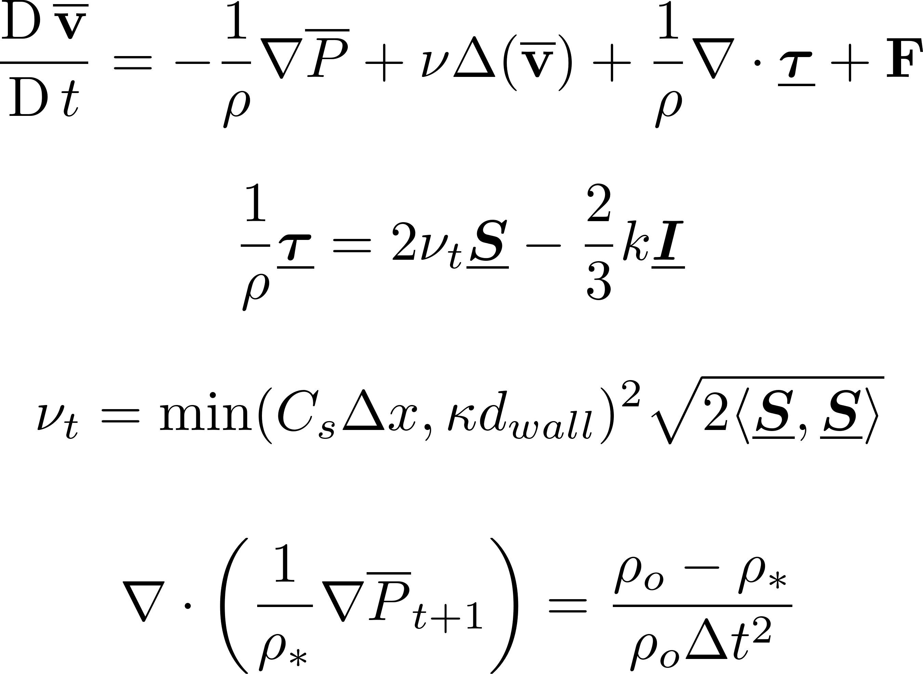
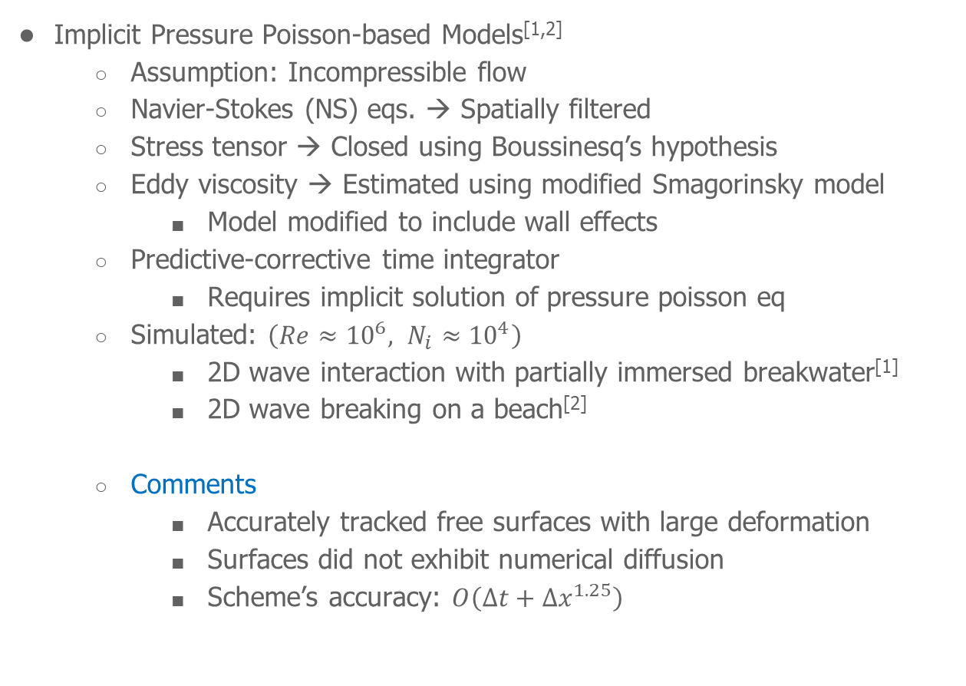
Large-Eddy Simulation-based Models
Implicit Pressure Poisson-based Models^{[1,2]}
Assumption: Incompressible flow
Navier-Stokes (NS) eqs. → Spatially filtered
Stress tensor → Closed using Boussinesq’s hypothesis
Eddy viscosity → Estimated using modified Smagorinsky model
Model modified to include wall effects
Predictive-corrective time integrator
Requires implicit solution of pressure poisson eq
Simulated: $\left(Re≈{10}^{6}, N_{i}≈{10}^{4}\right)$
2D wave interaction with partially immersed breakwater^{[1]}
2D wave breaking on a beach^{[2]}
Comments
Accurately tracked free surfaces with large deformation
Surfaces did not exhibit numerical diffusion
Scheme’s accuracy: $O\left(Δt+Δx^{1.25}\right)$
Fig: Time sequences of wave profile. (Rep: Gotoh et al)
[1] H. Gotoh, S. Shao, and T. Memita, “SPH-LES model for numerical investigation of wave interaction with partially immersed breakwater,” Coast. Eng. J., vol. 46, no. 1, pp. 39–63, 2004, doi: 10.1142/S0578563404000872.
[2] S. Shao and H. Gotoh, “Turbulence particle models for tracking free surfaces,” J. Hydraul. Res., vol. 43, no. 3, pp. 276–289, May 2005, doi: 10.1080/00221680509500122.
Notes:
Model is modified to include wall effects, s.t., it is not over-dissipative inside laminar layer

Slide 9
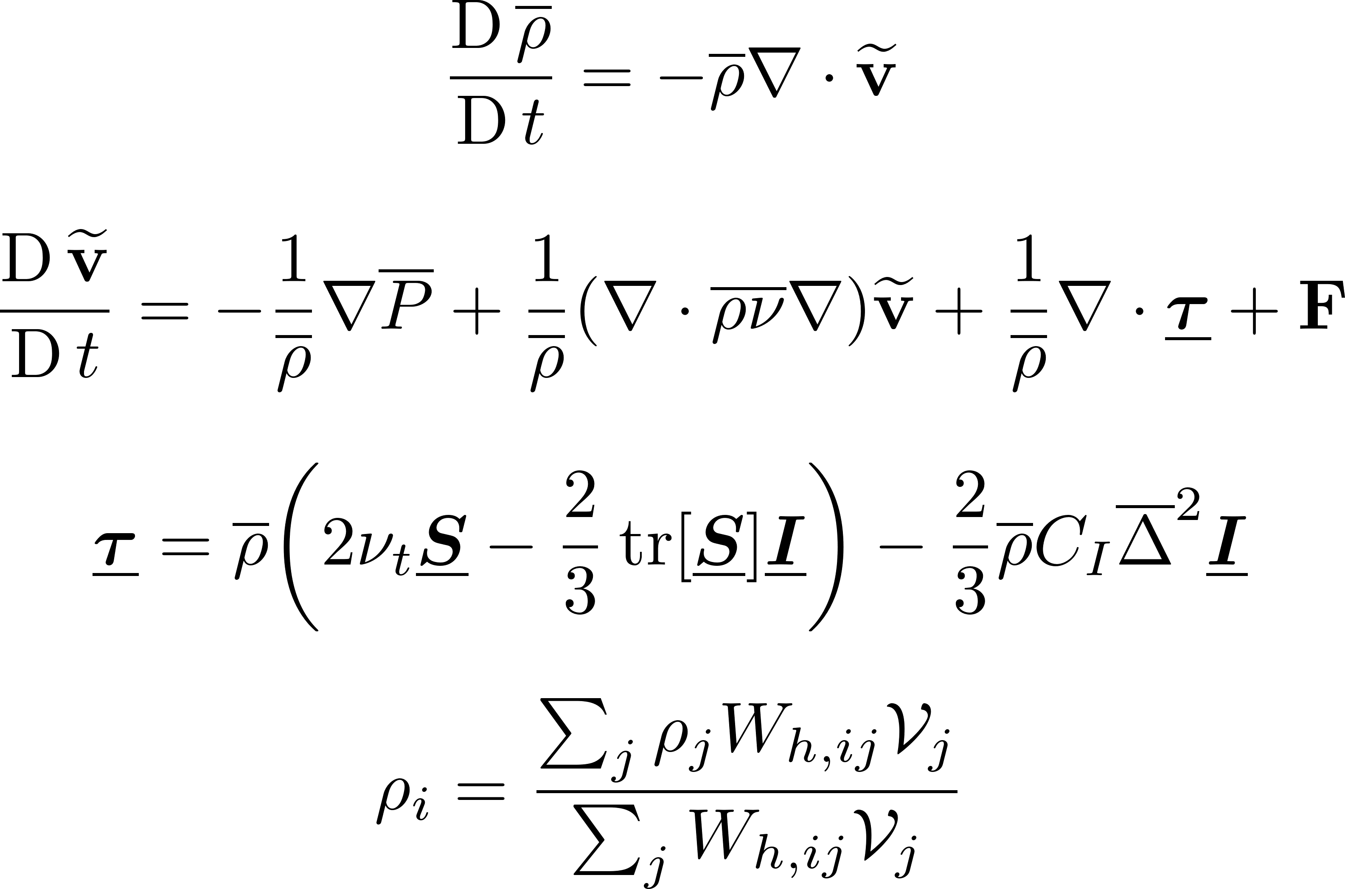

Large-Eddy Simulation-based Models
Explicit Pressure EOS-based Models^{[1,2]}
Assumption: Compressible flow
NS eqs → Favre averaged
Observation: Density variations → Unphysical behaviour on free surfaces
Shepard filtering of density performed periodically
Simulated: $\left(Re≈{10}^{6}, N_{i}≈{10}^{4}\right)$
Weakly plunging breaker in 2D & 3D^{[1]}
2D green-water overtopping, 2D & 3D wave breaking, 3D dam break^{[2]}
Comments
Model predicted regions of high vorticity in 2D
Model captured vertically oriented eddies in 3D
Accurate for flow separation or splash-based problems
Requires large $N_{i}$ & very small $Δt$
Uncertain regarding scalability to large-scale problems
[1] B. D. ROGERS and R. A. DALRYMPLE, “SPH MODELING OF BREAKING WAVES,” in Coastal Engineering 2004, Apr. 2005, pp. 415–427, doi: 10.1142/9789812701916_0032.
[2] R. A. Dalrymple and B. D. Rogers, “Numerical modeling of water waves with the SPH method,” vol. 53, pp. 141–147, 2006, doi: 10.1016/j.coastaleng.2005.10.004.

Slide 10
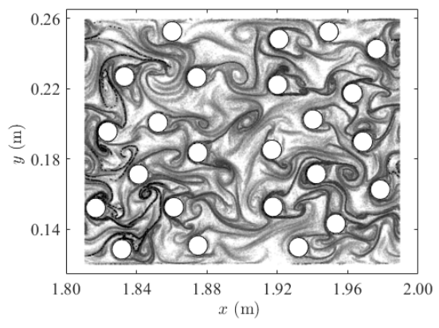
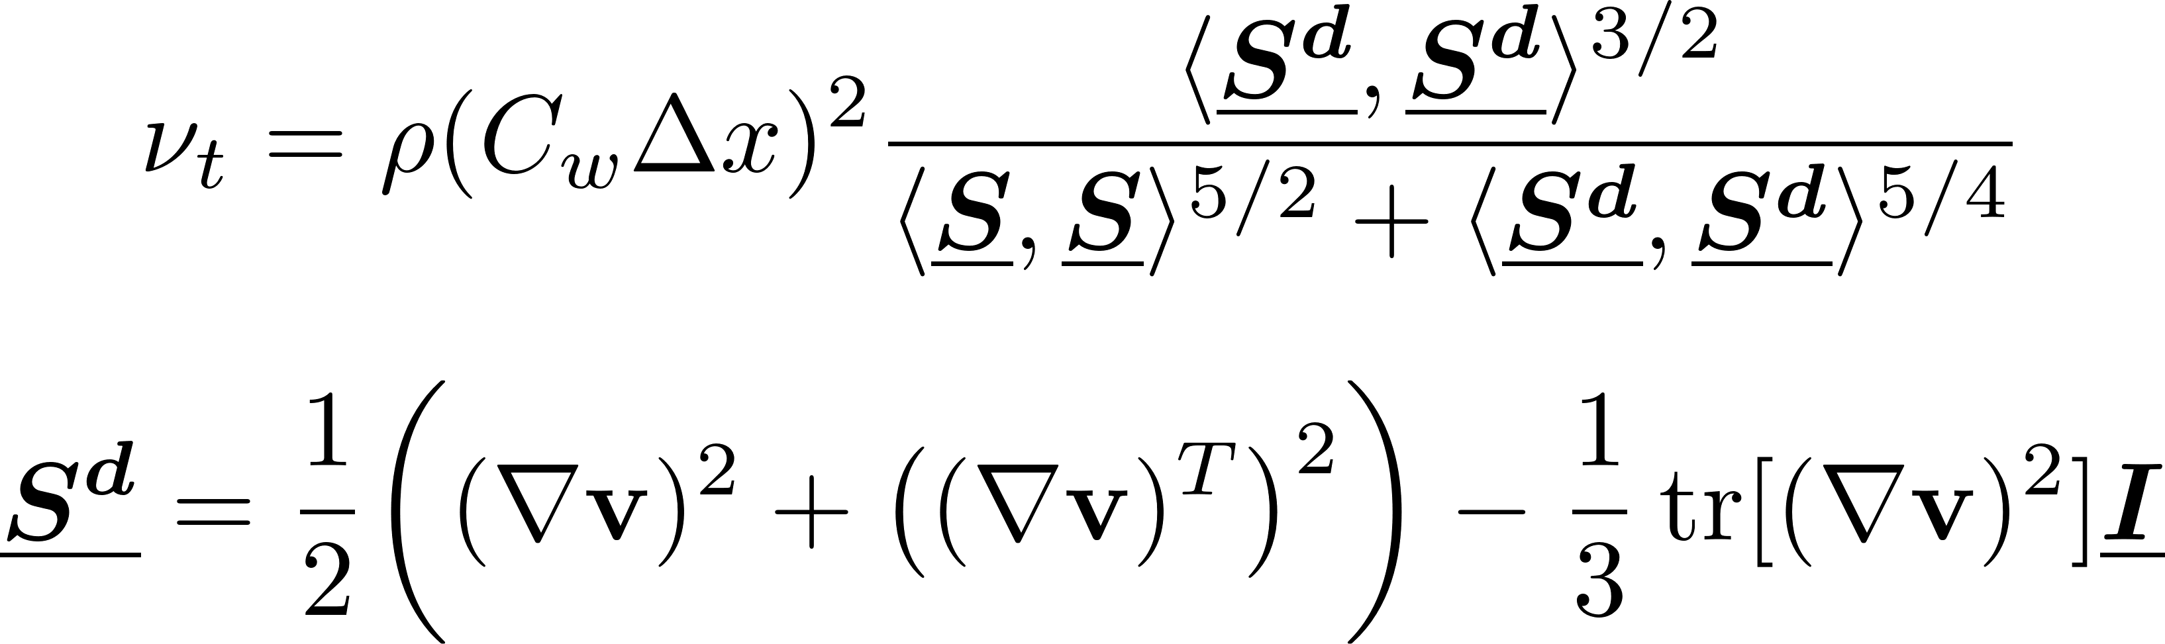

Large-Eddy Simulation-based Models
Explicit Pressure EOS-based Models^{[1]}
Observation: Standard Smagorinsky model cannot enforce
Wall conditions
Non-vanishing stresses with laminar flows
Devised Wall-adapting local eddy viscosity model (WALE)
Simulated an array of cylinders in 2D flow $\left(Re≈{10}^{2}, N_{i}≈{10}^{4}\right)$
Comments
LCS captured reasonably well
Observed merging of vortices to larger structures
Interactions of vortices with opposing strengths → Vorticity cancellation
Claim: Complex vortex interactions → Possible difficulty in interpreting the energy spectrum
Fig: Backward-in-time FTLE field. (Rep: Canelas et al)
[1] R. B. Canelas, A. M. Ricardo, R. M. L. Ferreira, J. M. Domínguez, and A. J. C. Crespo, “Hunting for Lagrangian Coherent Structures : SPH-LES turbulence simulations with Wall-adapting Local Eddy Viscosity ( WALE ) model,” 11th SPHERIC, no. March 2017, 2016, [Online].

Slide 11
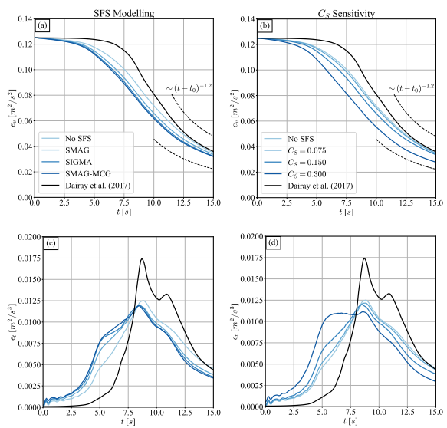

Large-Eddy Simulation-based Models
Explicit Pressure EOS-based Models^{[1]}
Reinterpret SPH → Lagrangian quadrature technique for explicit LES
Kernel scale limits SPH’s physical resolution → Unsuitable DNS alternative
Navier-Stokes (NS) eqs. → Spatially filtered
Compared multiple Smagorinsky models
(standard, $σ$, MCG-form)
Simulated 3D TGV $\left(Re≈{10}^{4}, N_{i}={200}^{3}−{500}^{3}\right)$
Comments
Smagorisnky models reduced averaged kinetic energy
Dissipation rates not predicted accurately
SPH can capture turbulence up to kernel scale (high cost)
Explicit SGS models remove kinetic energy → Increases energy deficit of standard SPH
“SGS models in SPH framework only degrade the quality of the subsonic turbulent flow approximation”^{[2]}
Fig: Density-weighted averaged kinetic energy (top), averaged dissipation rate (bottom). (Rep: Okraschevski et al)
[1] M. Okraschevski, N. Bürkle, R. Koch, and H.-J. Bauer, “Smoothed Particle Hydrodynamics Physically Reconsidered -- The Relation to Explicit Large Eddy Simulation and the Issue of Particle Duality,” 2022, [Online].
[2] D. Rennehan, “Mixing matters,” Mon. Not. R. Astron. Soc., vol. 506, no. 2, pp. 2836–2852, 2021.

Slide 12
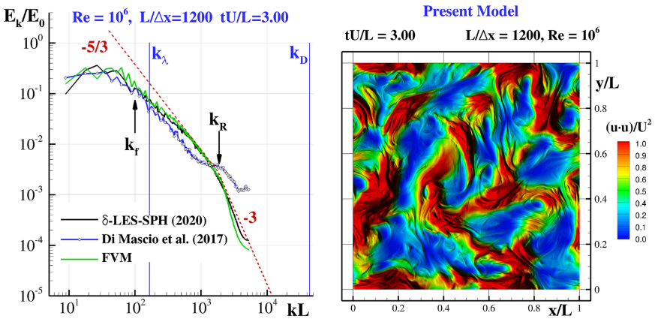
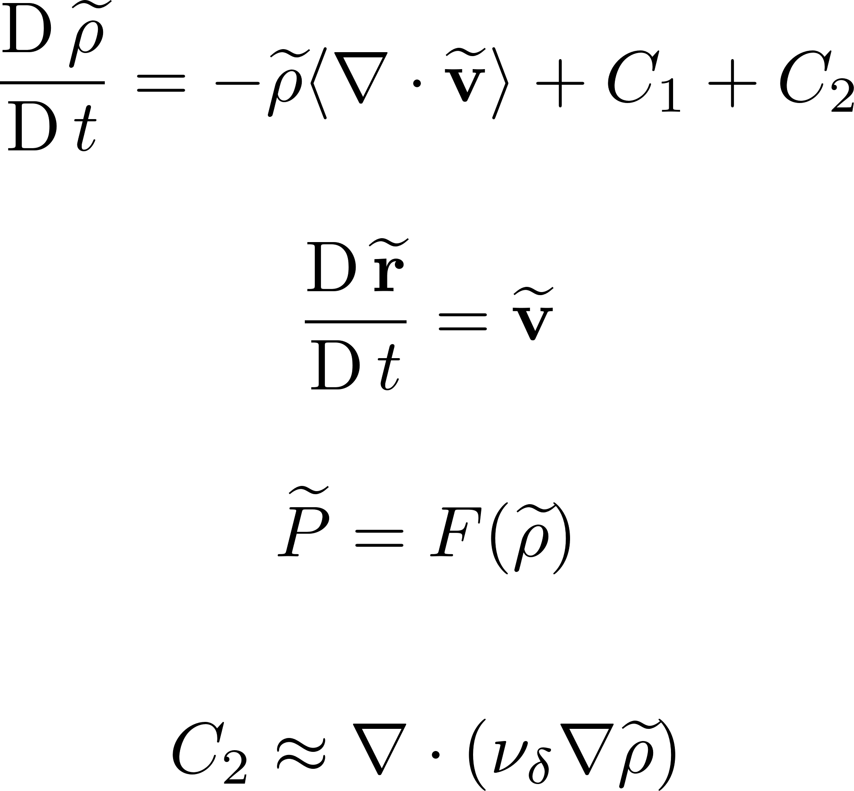
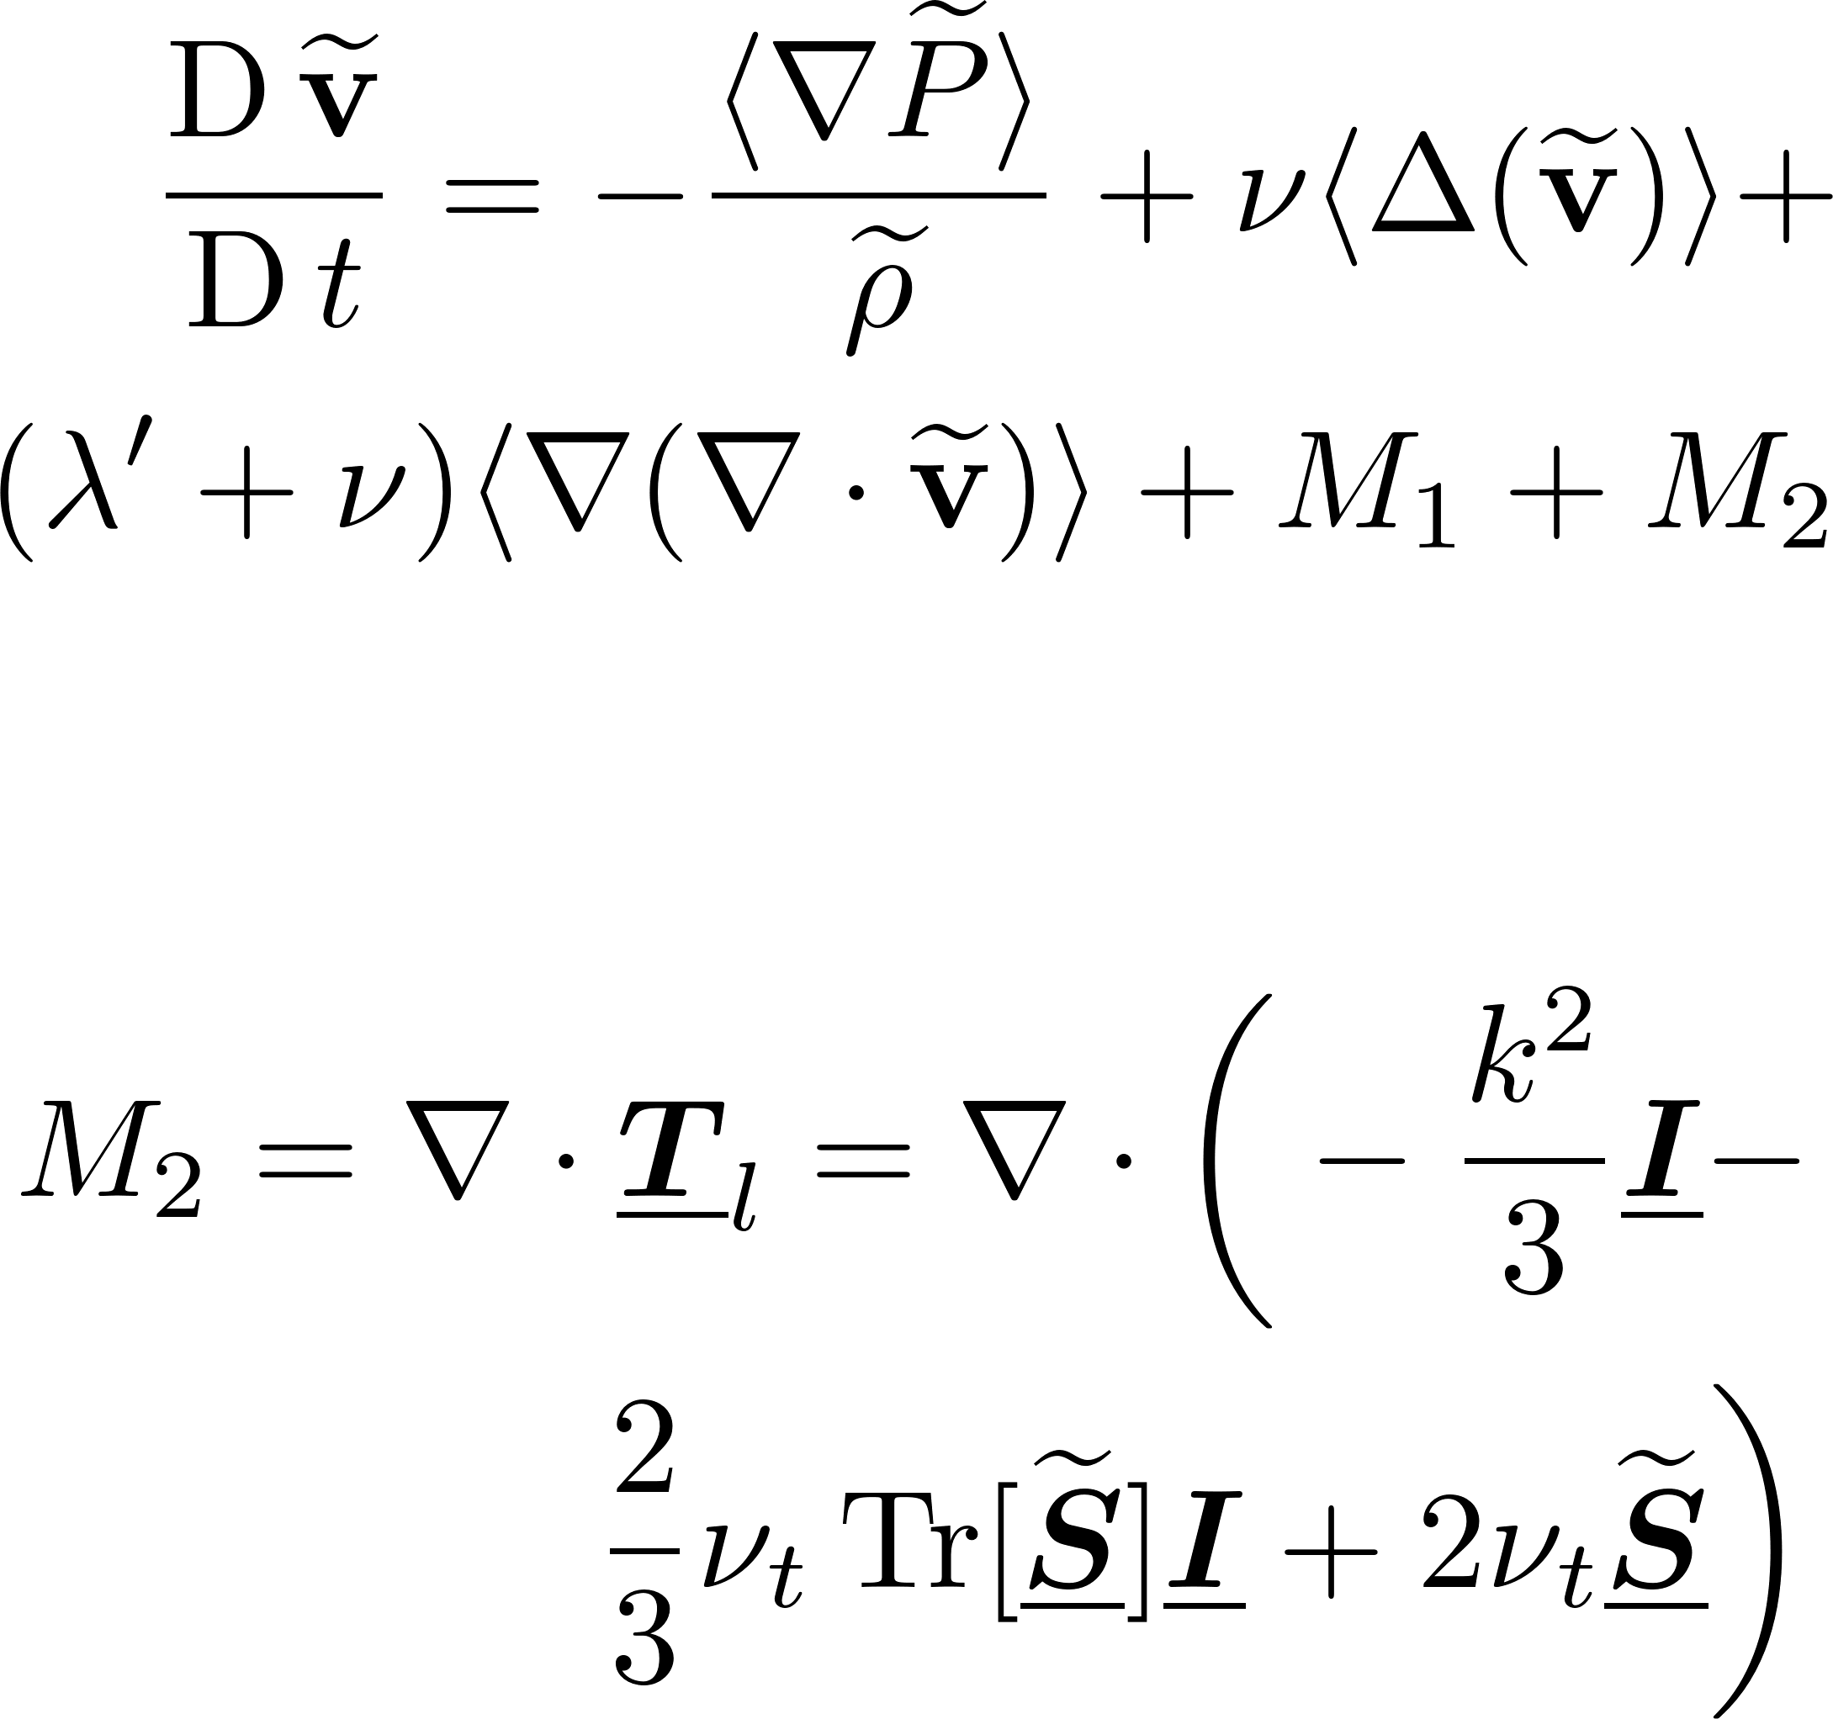


Lagrangian LES-based Models
Lagrangian form of LES^{[1,2]}
Assumption: Weakly compressible flow
Lagrangian filter - $ϕ$ (compact support, even) introduced
$ϕ$ decomposed into independent spatial & temporal components
Governing eqs. written using spatially filtered terms
Temporal terms of higher order neglected
Continuity eq. closed using Fick-like diffusion term
MOM eq. closed using Yoshizawa-model for the stress tensor
Considered $δ$-SPH formulation
Simulated:
2D TGV $\left(Re≈{10}^{3}−{10}^{6}, N_{i}≈{10}^{3}−{10}^{6}\right)$
3D homogenous turbulence $\left(Re≈{10}^{3}, N_{i}={64}^{3}−{256}^{3}\right)$
Comments
The model overcomes issues of spurious high-frequency noise & onset of tensile instability (High $Re$ flows)
The energy spectra agrees well with theoretical decay rate
Wall functions need to be incorporated to deal with boundaries
Higher-order approach can significantly improve the performance
Fig: Energy spectrum (left), $k$ field (right). (Rep: Colagrossi2021)
[1] A. Di Mascio, M. Antuono, A. Colagrossi, and S. Marrone, “Smoothed particle hydrodynamics method from a large eddy simulation perspective,” Phys. Fluids, vol. 29, no. 3, 2017, doi: 10.1063/1.4978274.
[2] A. Colagrossi, “Smoothed particle hydrodynamics method from a large eddy simulation perspective . Generalization to a quasi-Lagrangian model Smoothed particle hydrodynamics method from a large eddy simulation perspective . Generalization to a quasi-Lagrangian model,” vol. 015102, no. December 2020, 2021, doi: 10.1063/5.0034568.

Slide 13
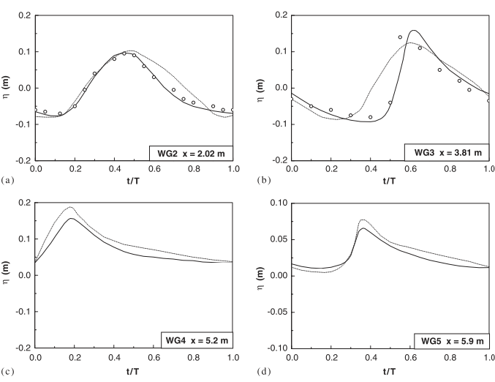
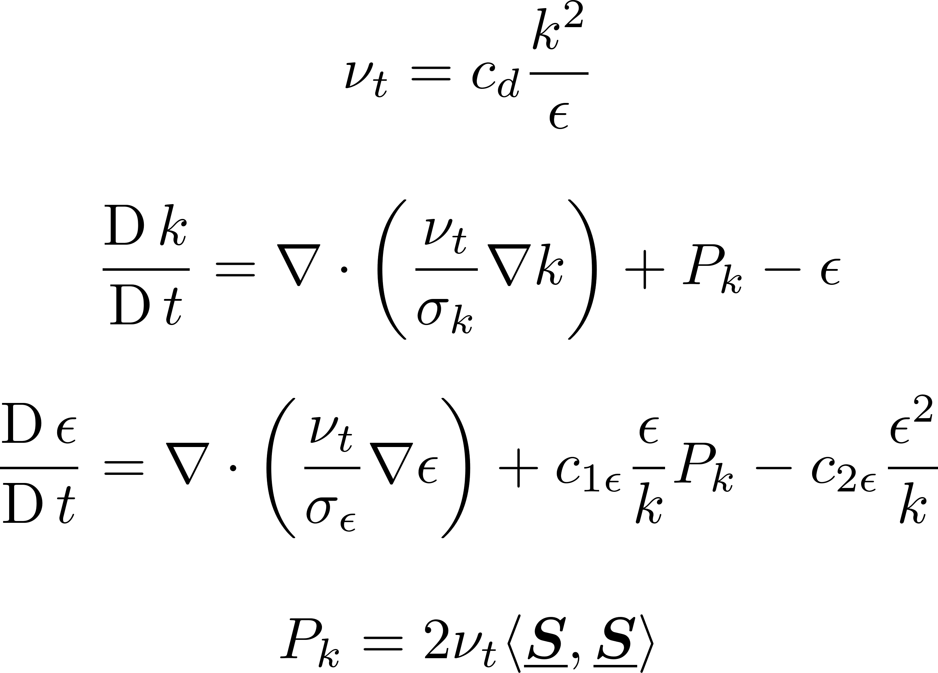

RANS-based $k−ε$ Models
$k−ε$ Models^{[1,2]}
Considered incompressible, unsteady RANS equations
Predictive-corrective time integrator
Requires implicit solution of pressure poisson eq
Simulated:
2D wave breaking and overtopping of sloping wall^{[1]} $\left(Re≈{10}^{6}, N_{i}=6000\right)$
2D solitary wave propagating over a bottom-mounted barrier^{[2]} $\left(Re≈{10}^{6}, N_{i}≈1.3×{10}^{5}\right)$
Comments
Accurately tracks free-surfaces
$k−ε$ coefficients (empirically derived from quasi-steady state) perform sub-optimally in transient flow
Model requires a sensitivity analysis for the turbulence model & spatial resolution for improved performance
Underpredicts max $k$ & is sensitive to initial seeding of $k$
Effects of viscous dissipation & numerical dissipation need to be balanced
Fig: Water surface elevations. (Rep: Shao et al)c
[1] S. Shao, “Incompressible SPH simulation of wave breaking and overtopping with turbulence modelling,” no. May 2005, pp. 597–621, 2006.
[2] D. Wang and P. L. F. Liu, “An ISPH with k–ε closure for simulating turbulence under solitary waves,” Coast. Eng., vol. 157, no. July 2019, p. 103657, 2020, doi: 10.1016/j.coastaleng.2020.103657.

Slide 14
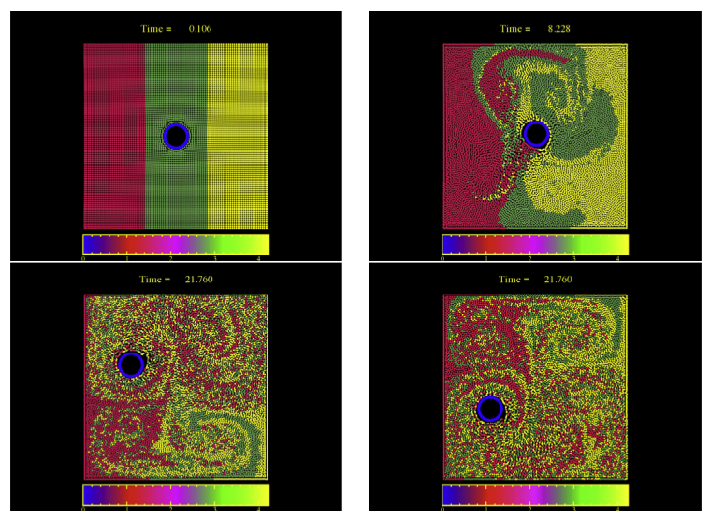
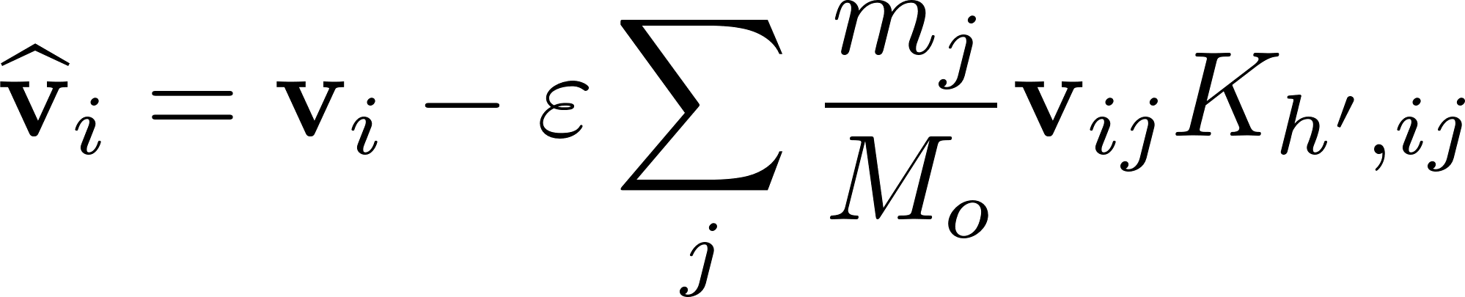

LANS-based Models
Lagrangian-averaged NS eqs. (LANS-$α$) Models^{[1,2,3,4]}
Lagrangian-averaging^{[1]}: Performed at the level of variational principle from which NS eqs. are derived
$α$ denotes scale of rapid fluctuations in the flow map
SPH-$α$ model^{[2]} → Initial models based on LANS-$α$ eqs.
Particle transport → Smoothed velocity
MOM eq. solved iteratively
SPH-$ε$ model^{[3,4]} → Improvement of SPH-$α$ model
Explicit MOM eq. with viscous term
Simulated 2D flow past a cylinder moving along a Lissajous curve^{[4]} $\left(Re≈{10}^{3}, N_{i}≈{10}^{4}\right)$
Comments
Bounded (no-slip) flow implies $v$is neither periodic/isotropic → Author prefers correlation functions over energy spectrum
Satisfactory results for velocity correlation functions, energy spectrum & mixing with half the particle resolution of DNS
Flows with larger Reynolds numbers & other boundary conditions, such as free surfaces need to be studied
Fig: Stirring of coloured particles. (Rep: Monaghan2017)
[1] J. E. Marsden and S. Shkoller, “Global well-posedness for the Lagrangian averaged Navier-Stokes (LANS-α) equations on bounded domains,” Philos. Trans. R. Soc. A Math. Phys. Eng. Sci., vol. 359, no. 1784, pp. 1449–1468, 2001, doi: 10.1098/rsta.2001.0852.
[2] J. J. Monaghan, “SPH compressible turbulence,” vol. 852, pp. 843–852, Apr. 2002, doi: 10.1046/j.1365-8711.2002.05678.x.
[3] J. J. Monaghan, “A turbulence model for smoothed particle hydrodynamics,” Eur. J. Mech. B/Fluids, vol. 30, no. 4, pp. 360–370, 2011, doi: 10.1016/j.euromechflu.2011.04.002.
[4] J. J. Monaghan, “SPH-ϵ simulation of 2D turbulence driven by a moving cylinder,” Eur. J. Mech. B/Fluids, vol. 65, pp. 486–493, 2017, doi: 10.1016/j.euromechflu.2017.03.011.

Slide 15
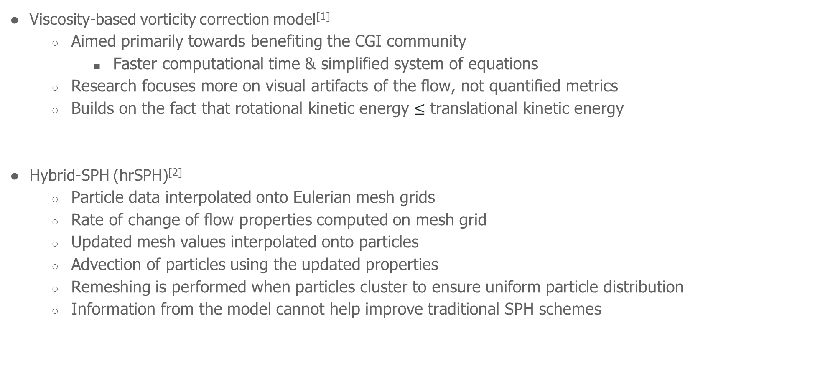
Miscellaneous Models
Viscosity-based vorticity correction model^{[1]}
Aimed primarily towards benefiting the CGI community
Faster computational time & simplified system of equations
Research focuses more on visual artifacts of the flow, not quantified metrics
Builds on the fact that rotational kinetic energy $≤$ translational kinetic energy
Hybrid-SPH (hrSPH)^{[2]}
Particle data interpolated onto Eulerian mesh grids
Rate of change of flow properties computed on mesh grid
Updated mesh values interpolated onto particles
Advection of particles using the updated properties
Remeshing is performed when particles cluster to ensure uniform particle distribution
Information from the model cannot help improve traditional SPH schemes
[1] S. Liu, X. Wang, X. Ban, Y. Xu, J. Zhou, and Y. Zhang, “Viscosity-based Vorticity Correction for Turbulent SPH Fluids,” in 2019 IEEE Conference on Virtual Reality and 3D User Interfaces (VR), Mar. 2019, pp. 1048–1049, doi: 10.1109/VR.2019.8798224.
[2] A. Obeidat and S. P. A. Bordas, “Three-dimensional remeshed smoothed particle hydrodynamics for the simulation of isotropic turbulence,” Int. J. Numer. Methods Fluids, vol. 86, no. 1, pp. 1–19, 2018, doi: 10.1002/fld.4405.

Slide 16
Most of Lagrangian turbulent models → Tested for primarily complex, free-surface flows
A systematic analysis of isotropic turbulence problems provides better insight on the energy spectrum & its cascade across varying length scales
Appropriate bounded/periodic test cases must be used when analyzing turbulence
Analyse results with appropriate metrics, and validate the results with experimental or numerical data from literature
Evaluation of Turbulence Models
Benchmark Problems
Various Turbulence Models
Post-simulation Analysis
Model Validation
Model Improvement

Slide 17
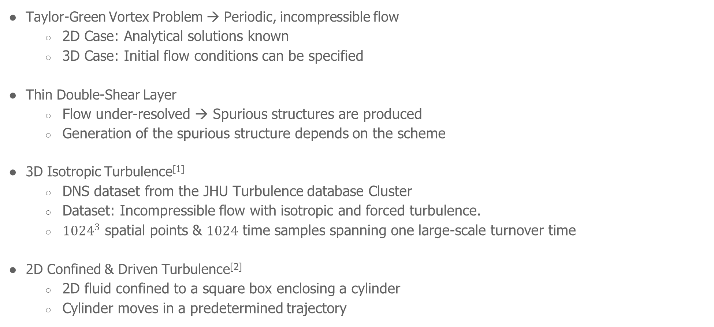
Benchmark Problems
Taylor-Green Vortex Problem → Periodic, incompressible flow
2D Case: Analytical solutions known
3D Case: Initial flow conditions can be specified
Thin Double-Shear Layer
Flow under-resolved → Spurious structures are produced
Generation of the spurious structure depends on the scheme
3D Isotropic Turbulence^{[1]}
DNS dataset from the JHU Turbulence database Cluster
Dataset: Incompressible flow with isotropic and forced turbulence.
${1024}^{3}$ spatial points & $1024$ time samples spanning one large-scale turnover time
2D Confined & Driven Turbulence^{[2]}
2D fluid confined to a square box enclosing a cylinder
Cylinder moves in a predetermined trajectory
[1] Y. Li et al., “A public turbulence database cluster and applications to study Lagrangian evolution of velocity increments in turbulence,” J. turbul., vol. 9, p. N31, 2008.
[2] J. J. Monaghan, “SPH-ϵ simulation of 2D turbulence driven by a moving cylinder,” Eur. J. Mech. B/Fluids, vol. 65, pp. 486–493, 2017, doi: 10.1016/j.euromechflu.2017.03.011.

Slide 18
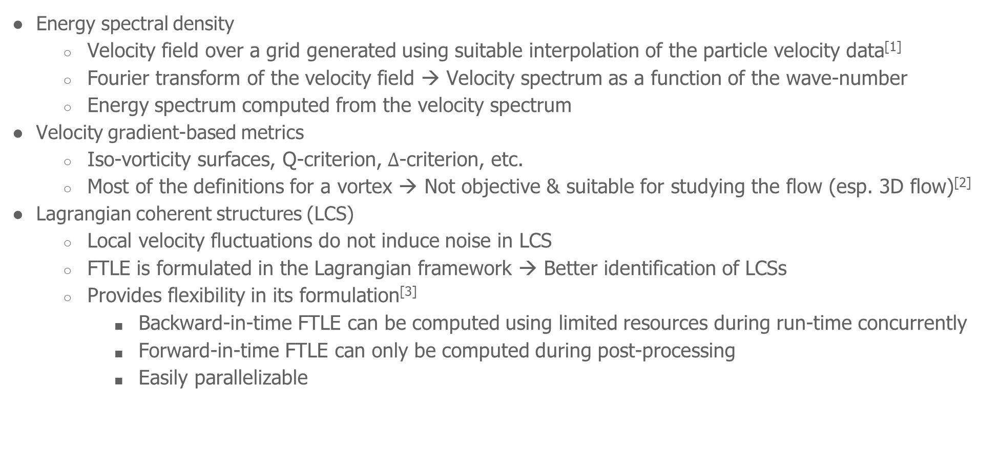
Post-Simulation Analysis
Energy spectral density
Velocity field over a grid generated using suitable interpolation of the particle velocity data^{[1]}
Fourier transform of the velocity field → Velocity spectrum as a function of the wave-number
Energy spectrum computed from the velocity spectrum
Velocity gradient-based metrics
Iso-vorticity surfaces, Q-criterion, $Δ$-criterion, etc.
Most of the definitions for a vortex → Not objective & suitable for studying the flow (esp. 3D flow)^{[2]}
Lagrangian coherent structures (LCS)
Local velocity fluctuations do not induce noise in LCS
FTLE is formulated in the Lagrangian framework → Better identification of LCSs
Provides flexibility in its formulation^{[3]}
Backward-in-time FTLE can be computed using limited resources during run-time concurrently
Forward-in-time FTLE can only be computed during post-processing
Easily parallelizable
[1] Y. Shi, X. X. Zhu, M. Ellero, and N. A. Adams, “Analysis of interpolation schemes for the accurate estimation of energy spectrum in Lagrangian methods,” Comput. Fluids, vol. 82, pp. 122–131, 2013, doi: 10.1016/j.compfluid.2013.05.003.
[2] G. Haller, “An objective definition of a vortex,” J. Fluid Mech., vol. 525, pp. 1–26, 2005.
[3] P. N. Sun, A. Colagrossi, S. Marrone, and A. M. Zhang, “Detection of Lagrangian Coherent Structures in the SPH framework,” Comput. Methods Appl. Mech. Eng., vol. 305, pp. 849–868, 2016, doi: 10.1016/j.cma.2016.03.027.

Slide 19

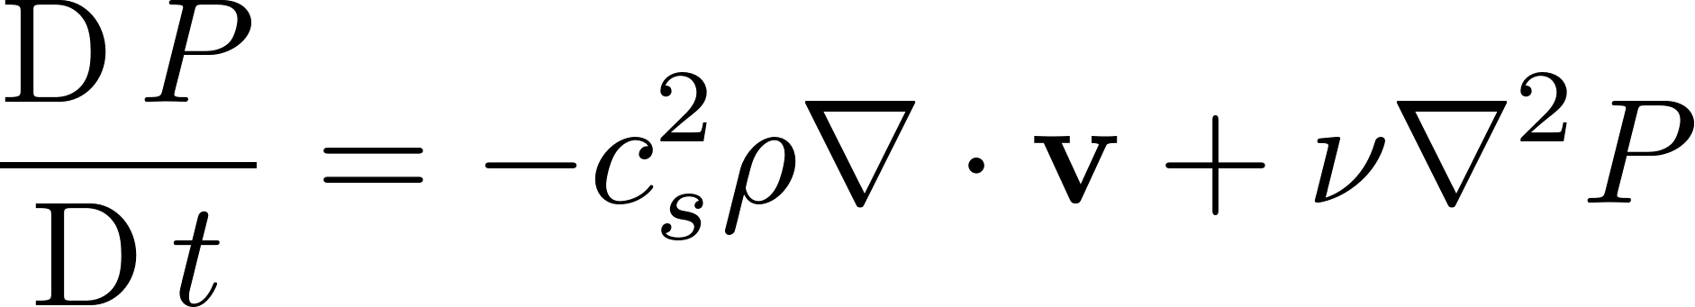
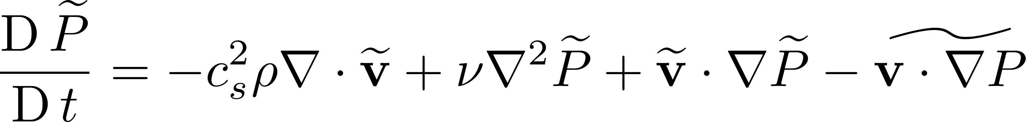
Conclusion & Future Work
Stage – I outcome:
A reasonable compilation of past SPH turbulence models
The corresponding advantages, limitations & potential areas for refinement are understood
Entropically Damped Artificial Compressibility (EDAC) scheme^{[1]} → Explicit incompressible SPH method
Uses a pressure evolution eq. instead of the continuity equation^{[2]}
Produces a smoother & accurate pressure distribution for flows, confined or free
Does not require artificial viscosity
Turbulence Models for EDAC
Incompatible with RANS due to incompressibility condition
Will consider compressible EDAC scheme to devise a turbulence model
Lagrangian LES filtering of the pressure eq → Mixed filtered term obtained; cannot be decoupled further
Will investigate potential closure models to decouple/model the mixed term
[1] P. Ramachandran and K. Puri, “Entropically damped artificial compressibility for SPH,” Comput. Fluids, vol. 179, pp. 579–594, Jan. 2019, doi: 10.1016/j.compfluid.2018.11.023.
[2] J. R. Clausen, “Entropically damped form of artificial compressibility for explicit simulation of incompressible flow,” Phys. Rev. E - Stat. Nonlinear, Soft Matter Phys., vol. 87, no. 1, pp. 1–12, 2013, doi: 10.1103/PhysRevE.87.013309.

Slide 20
Thank you!
Department of Aerospace Engineering
Indian Institute of Technology Bombay
October 25th, 2022

